Slide 1

EV4 Wiring by
K. Ferhat Celik
We support you when your ideas start elevating

Slide 2

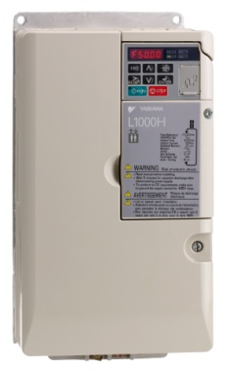
EV40-F Layout
EV4
DOWN travel: Conventional (mechanical)
Elevator controller
UP travel with inverter
EV4 Valve
EV4
YASKAWA
L1000H
OPEN loop control
Pump
Uses the standard power unit
Covers up 80% of applications
Temp. sensor
Motor

Slide 3


YASKAWA Drives for the EV4 system
kW size | L1000H – 400V
 | Drive Code | Line Filter | AC Reactor
3 | LC4V0007BAA-0011 | FS23639-15-07 | B 0903084
4 | LC4V0009BAA-0011
5.5 | LC4V0015FAA-0011 | FS23639-30-07 | B 0903085
7.5 | LC4F0018BAC-9120 | FB-40025A
11 | LC4F0024BAC-9120 | FB-40044A | B 1103139
15 | LC4F0031BAC-9120 |  | B 1103140
18.5 | LC4F0039BAC-9120 |  | B 11030141
22 | LC4F0045BAC-9120 | FB-40060A
30 | LC4F0060BAC-9120 |  | B 1103142
37 | LC4F0075BAC-9120 | FB-40105A
45 | LC4F0091BAC-9120 |  | B 0910013
55 | LC4F0112CAC-9120 | FB-40170A
75 | LC4F0150CAC-9120
L1000H – 200V drives are also available !
Drive selection is done according to the required current.
Example: CIMR-LC4F0039BAC-09120
4 shows that it is a 400V drive
39 indicates the nominal current available from the drive (+40% overload is possible for 45 seconds)
Voltage range of the drive should match with the mains power!

Slide 4
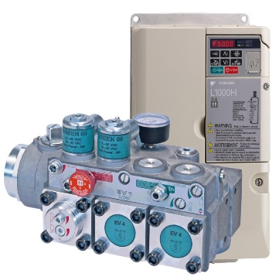
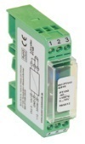
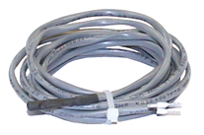
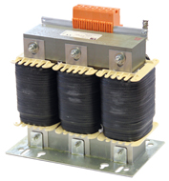
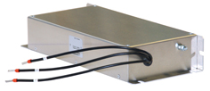
What is received in an EV4 package?
EV4 package
EV4 valve
L1000H Yaskawa Drive
Temperature converter & temperature sensor
Line filter
AC Reactor
EV4 User Manual
L1000H
Temp. Converter & Temp. sensor
Line filter
AC Reactor
A YASKAWA L1000H drive, which contains the hydraulic software, is delivered in the EV4 package. The package also includes a temperature converter, temperature sensor, line filter and AC reactor.

Slide 5
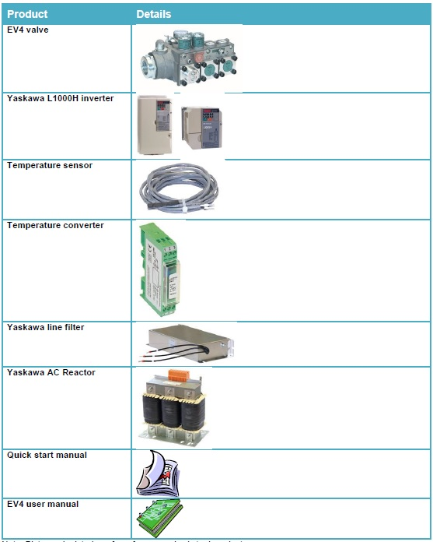
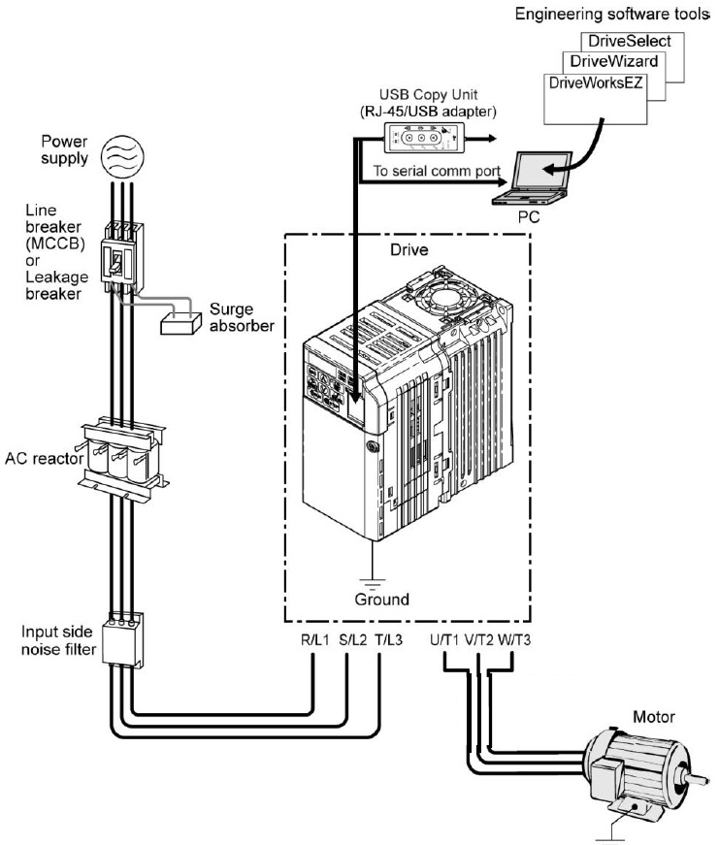
EV4 package content
Connection of electrical components
Temperature converter is also wired to the drive

Slide 6
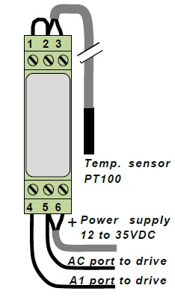
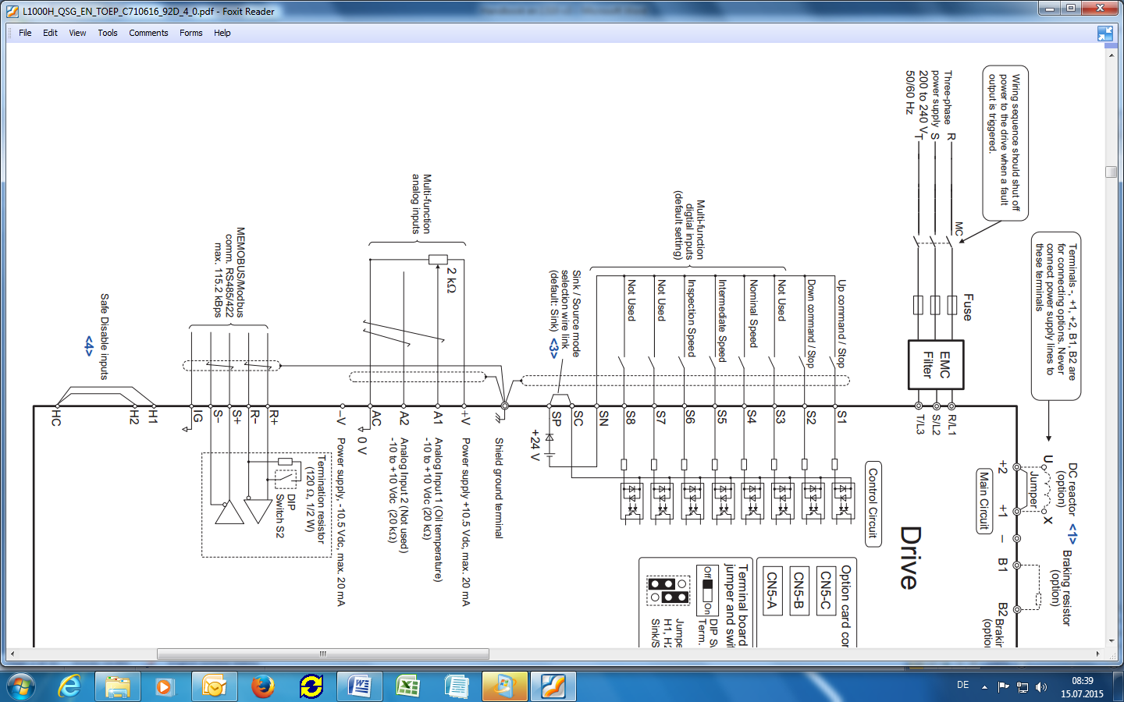
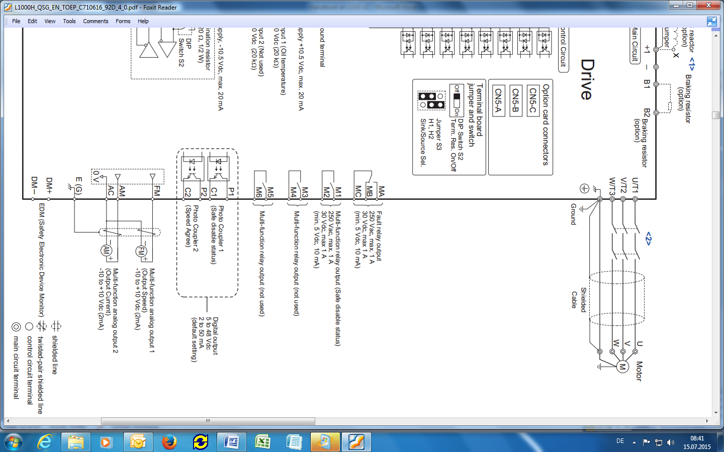
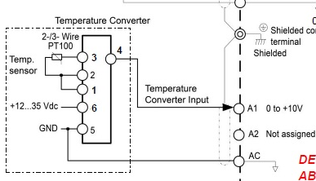
EV4 Electrical layout
Connections of temperature converter & temperature sensor (See page 15 of EV4 User Manual)
Correct connection of the temperature sensor is important. After completing wiring of the EV4 system, verify the connection by reading the temperature from the drive display unit. For that select U7-07 parameter from the monitor menu. Temperature reading is in °C. If U7-07 shows -50 or a minus temperature then the wiring must be wrong. Check the polarity of the power supply to the temperature converter.

Slide 7
Supply power and motor connections
Place the drive either in the existing controller cabinet or in a separate cabinet together with the line filter and AC reactor. Do the mains and motor connections (See page 12 & 16 of EV4 User Manual).
AC Reactor
YASKAWA
L1000H
Line Filter
Mains
D C
EV4
EV4
Motor contactors
MOTOR

Slide 8
UP travel signalling
As a default setting L1000H drive uses internal 24Vdc circuit for signalling. The terminals S1 to S8 on the drive are used for signalling. In order to provide a signal, for example to the S1 terminal, the circuit between SN and S1 should be bridged. To do that, an elevator controller may be designed to have relays (shown as RS1, RS4, RS5 and RS6 ) for each terminal. The relay circuit is provided by the elevator controller, it is not delivered in the EV4 package. When the elevator controller energizes, for example the relay RS1, the circuit switch closes and S1 signal is sent to the drive.
Meaning of the terminals
S1 terminal: S1 signal is necessary for an up travel. Without S1 signal the drive will not initiate any travel. If only S1 signal is sent to the drive, the drive travels at levelling speed. In order to perform re-levelling again only S1 signal is used.
Speed selection terminals S4, S5 and S5: These are used for speed selection. For a normal (full speed) travel S4 switch should be closed together with S1. Similarly for intermediate and inspection speeds S5 and S6 are closed respectively instead of S4. When more than one speed selection switches are closed the drive runs with the lowest selected speed.
Example: When a normal speed travel is to be done, S1 and S4 switches should be closed at the same time. By doing so elevator accelerates and reaches the normal (full) speed. As the car needs to decelerate the elevator controller removes (de-energizes RS4) the S4 signal. Then the car decelerates into the levelling speed and travels at that speed. As the S1 signal is removed (de-energizes RS1) by the controller the elevator stops. When the S1 signal is removed the elevator controller should run the motor 1 second longer (apply a motor delay) to allow soft stop. If Inspection travel is to be done, in this case the same sequence between S1 and S6 should be repeated.
Up call/ Levelling Speed/ Stop
S1
RS1
S2
S3
Nominal Speed
S4
Control Board
RS4
Intermediate Speed
S5
RS5
Inspection Speed
S6
RS6
SN
SC
SP
+24V
Elevator Controller
L1000H drive

Slide 9
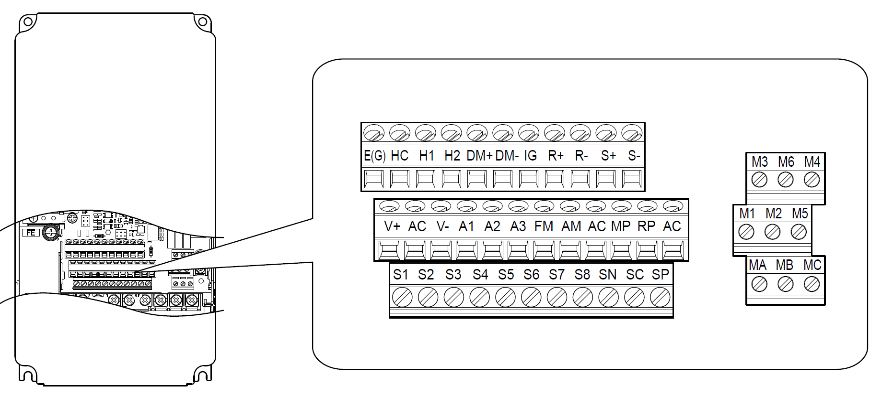
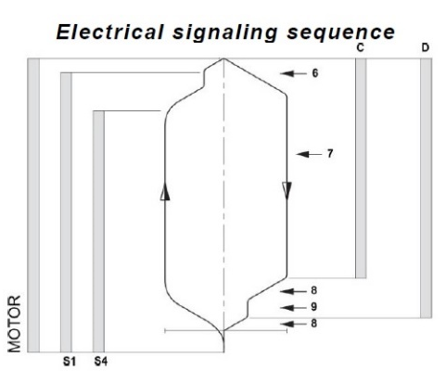
UP signalling of EV4 drive
L1000H
Decel.
switch
Elevator speed
1
Stop
switch
2
Input
common
Decel.
switch
Output frequency
Travel signals
1
Stop
switch
Full speed travel→ S1+S4
Intermediate full sp travel→ S1+S5
Inspection speed travel→ S1+S6
Levelling speed travel→ S1
2
3
S4 – Speed selection signal
S1 – Up run signal
Energy to motor contactors
Base block signal - optional
S1 is up travel signal, without S1 elevator will not move.
S4, S5 and S6 are speed selection signals, one of which should be used together with S1 for a travel.
Base block signal is optional. Unless base-block signal is removed by the elevator controller a run cannot occur.

Slide 10
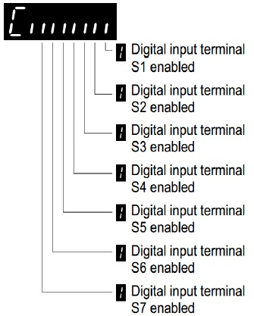
Verification of UP signalling
From Monitor menu verification of correct signalling can be done.
How? Go to Monitor menu and observe the parameter U1-10.
Monitor Menu, parameter U1-10: Input terminal status displayed as „0“ for no input otherwise „1“
Examples of runs
00000000
00000001
00001001
00100001
No signal received by the drive, elevator will not run
Levelling run: Only S1 signal is received
Nominal sp. run:
S1 and S4 signals are received
Inspection sp. run: S1 and S6 signals are received

Slide 11
Down coil wiring
The same sequence is applied for the down travel but in this case, energy is sent to the D & C coils on the EV4 valve by the elevator controller.
For full down speed D & C coils are energized.
To decelerate into slow speed C coil is de-energized. To stop at floor energy to the D coil is removed.
Connect the D and C coils to the controller outputs. If there will be an UCM/A3 valve connected to the control valve, its coil connection to the controller should also be done.
YASKAWA
L1000
Mains
D C
EV40
EV40
Motor contactors
The voltage to the down coils should match with the coil voltage on the EV4 valve.
MOTOR

Slide 12
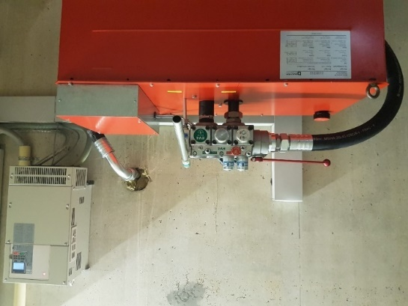
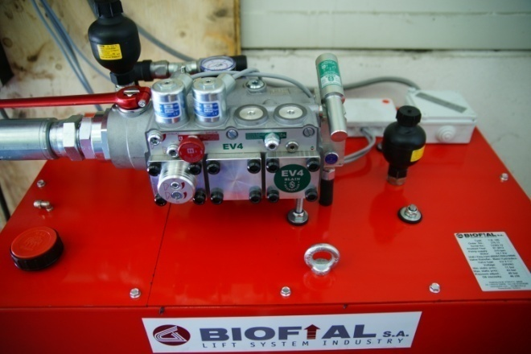
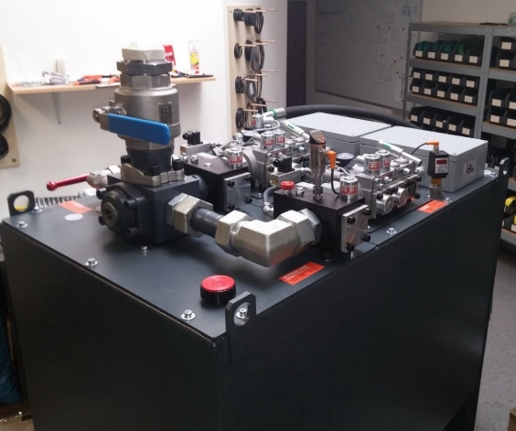
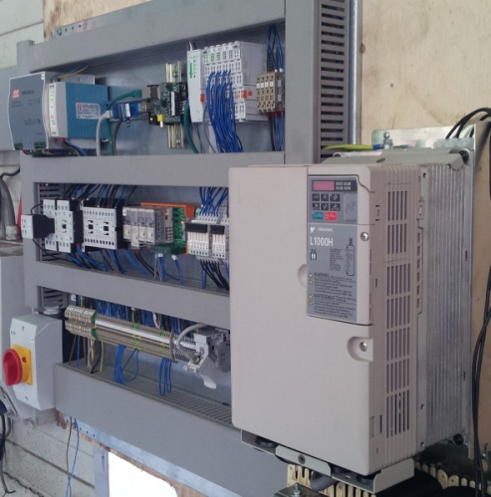
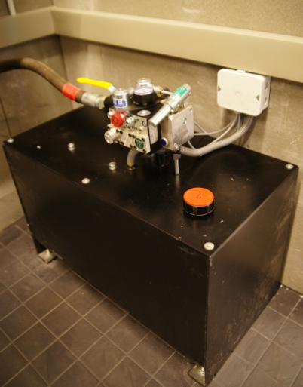
EV4 Modernization applications

Slide 13
